Slide 1


Optical Constants of CH₄ + N₂ Ice Mixtures and Outer Solar System Objects
Aidan Madden-Watson
Northern Arizona University

Slide 2
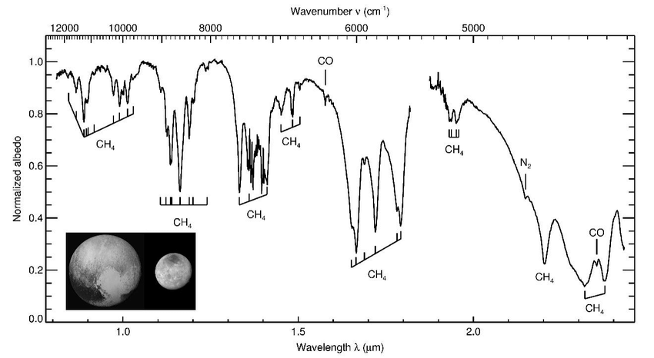
N₂ is hard to detect but it affects other elements’ spectra
Infrared spectrum of Pluto (including the negligible light from Charon), shown in the inset, compiled from 20 years of ground-based telescopic observations. The identified absorption bands of CH₄ and N₂ are marked. Data from B. J. Holler et al. (in preparation).
Notes:
This is Pluto’s spectra and it shows prominent CH4 bands throughout multiple wavelengths. However, what is noticeable and imperative for my research is the small “bump” that is the N2 band. It’s barely a blip on the spectra as a whole, telling the story that even if there is an abundance of nitrogen on icy dwarves we might not be able to tell.

Slide 3
Goal:
Determine how N₂ affects the C-H stretch by measuring the optical constants of CH₄ + N₂ ice mixtures

Slide 4
The Optical Constant Pipeline
Lab Experiments
Optical Constants (n , k)
Radiation Transfer Model
(Hapke Model)
Theoretical Spectrum
Telescope Observations
Telescope
Spectrum
Abundance of Ices
Notes:
The collaborative pipeline to find the abundance of ices on Icy Dwarves is extensive, but it starts with the work that my group is doing at NAU. With the lab experiments and analysis through code we receive optical constants that will then be put into a Radiation Transition Model, or Hapke model. This model will give a theoretical spectrum that can then be compared with telescope observations and an experimental spectrum to find the abundance of ice on an object that is being studied.

Slide 5
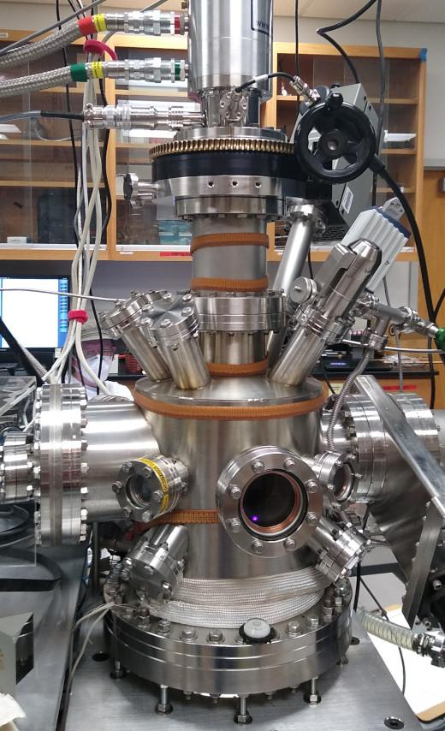
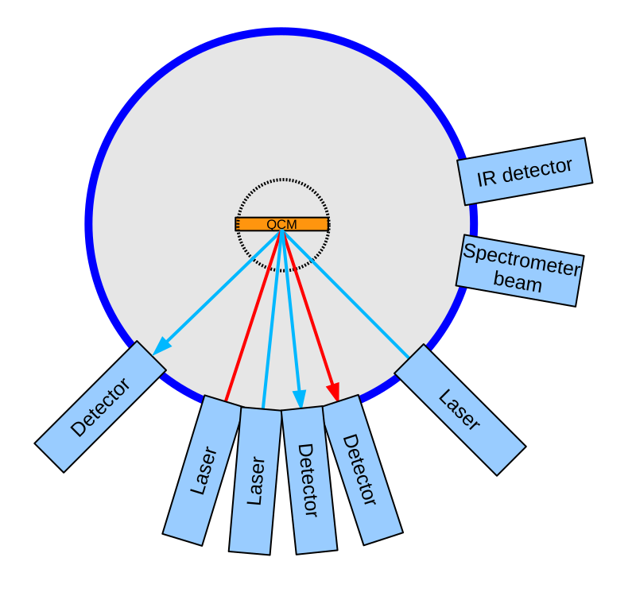
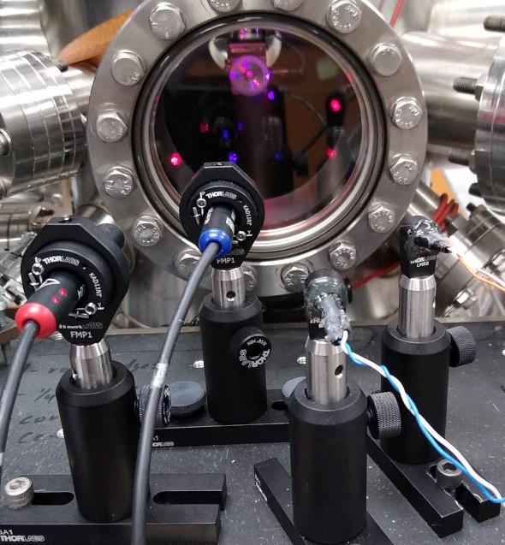
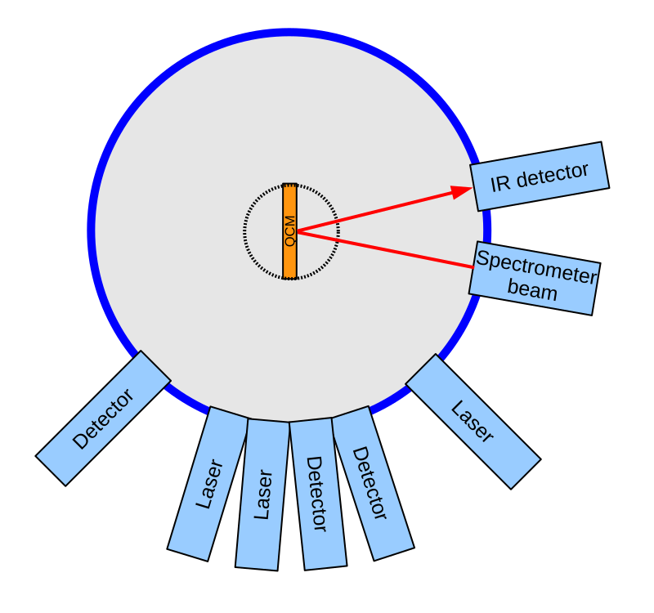
Thin film vacuum chamber
Main porthole with lasers aimed at Quartz Crystal Microbalance
Growing ice
Taking spectra of ice
Notes:
The experimental setup of this project was relatively easy if you happen to have a vacuum chamber that can cool itself to 10K and a sophisticated set of lasers. Not pictured here is a series of tubes setup to mix gases to put into the vacuum chamber. This is the system that allowed my group to form the CH4 + N2 mixes that we studied. When we grew the ice the QCM inside the chamber was pointed towards the porthole so that we could utilize lab programs to see how many “fringes” of ice were grown. These fringes corresponded to the approximate thickness of the ice, something that our group had to be careful of because (especially with methane ice) if you grow too much ice it can be oversaturated and provide bad data. Once the ice was grown, the entire inside of the system was rotated using the crank at the top of the leftmost picture so that it could point at the spectrometer and the spectra could be taken.

Slide 6
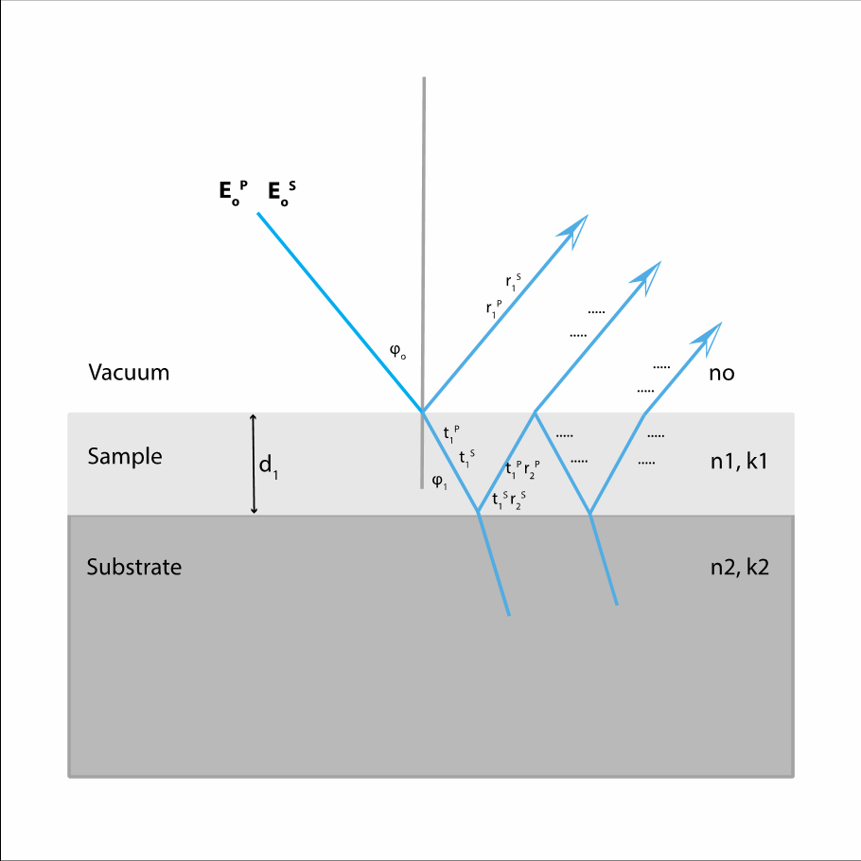
More on the physics of what goes on inside our thin film system

Slide 7
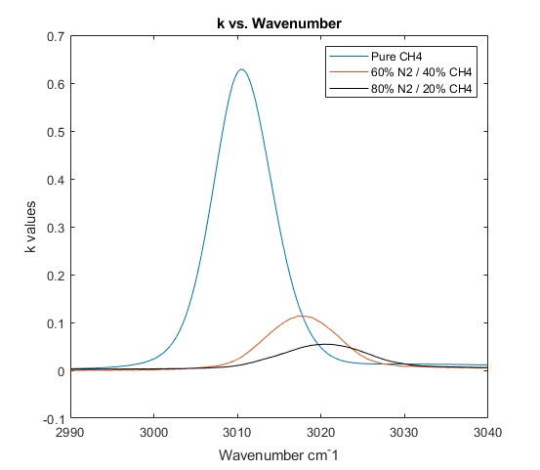
The presence of N₂ causes the CH₄ spectra to shift towards higher wavenumbers
Pictured here are k values of CH₄+N₂ mixtures and pure CH₄ (Gerakines & Hudson, 2020). You can see the obvious shift of the peak towards larger wavenumbers as more N₂ is added into the system.

Slide 8
Summary
Nitrogen affects the C-H stretch by making the peak of the spectra shift towards higher wavenumbers. The optical constants measured in this project will be useful for finding the abundance of N₂ on icy dwarfs not showing the weak N₂ band.

Slide 9
Acknowledgements
Dr. Stephen Tegler (Mentor)
Moises Gomez (Colleague)
Will Grundy (Lowell Astronomer)
Paloma Davidson (NAU Space Grant Coordinator)
Any Questions?

